Slide 1
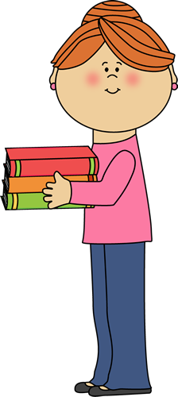
Welcome to the Library!
2016-2017

Slide 2
Your Librarian and Your Library
Opens at 8:45 – 9:00 am
Closes 3:00 – 3:20 pm
Monday, Wednesday, &
Thursday
Library website:
www.Falsecreeklibrary.weebly.com

Slide 3
Library Monitors
Meeting this coming Thursday or next Monday.
Listen for announcement
Helping out the library
Works with your schedule (before school, recess, lunch, after school)

Slide 4
Library Rules and Procedures
Enter the library quietly, stand in a straight line, and wait for further instructions.
If another class is exiting, please wait.
Always walk
Follow Directions
Keep hands, feet, and objects to yourself.
Use appropriate voice levels

Slide 5
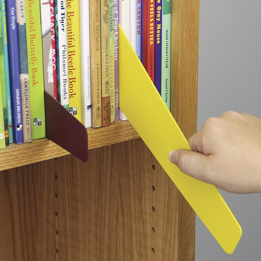
Library Rules and Procedures
Respect your classmates
Keep chair legs on the floor
ALWAYS use a shelf marker when looking for books
Handle library materials with care
Return books on time

Slide 6
Computer Lab
Absolutely no food or drinks in the lab
Noise level is low (especially when other classes are using the easy fiction area or table area) or you will be asked to leave
No music → USE HEADPHONES!!!!!
Must use appropriate websites
Push in chairs and tidy up after yourself!!!!
Opened after school ONLY for school work purpose
→ THIS MEANS NO GAMES!!!!!!!!!!

Slide 7
IPADS
Please do not eat or drink around an IPAD.
Handle with extreme care
Volume level should be no more than 4-5 levels high
You must return to IPAD cart in the appropriate number spot
Do not fiddle with the numbers written on the IPAD (ie. scratch, pick at it)
DO NOT LEAVE IPADS OUT & LYING AROUND!!

Slide 8
Fire/Earthquake Drill & Code Red (Lockdown)
Be alert and follow teacher instructions
Line up in a single file QUIETLY!
Earthquake: cover and duck under the tables
Fire: Line up at the door going to office.
Code RED (Lockdown): Line up and go into the office for safety and lockdown.

Slide 9
Checking out Books
Kindergartens – 1 book
Grades 1- 3 may check out three books
Grades 4 -7 may check out 5+ books
If you have 1 or more overdues, can’t sign out anymore books until they are returned.
Books are due back in 2 weeks
Fines for lost or damaged books

Slide 10
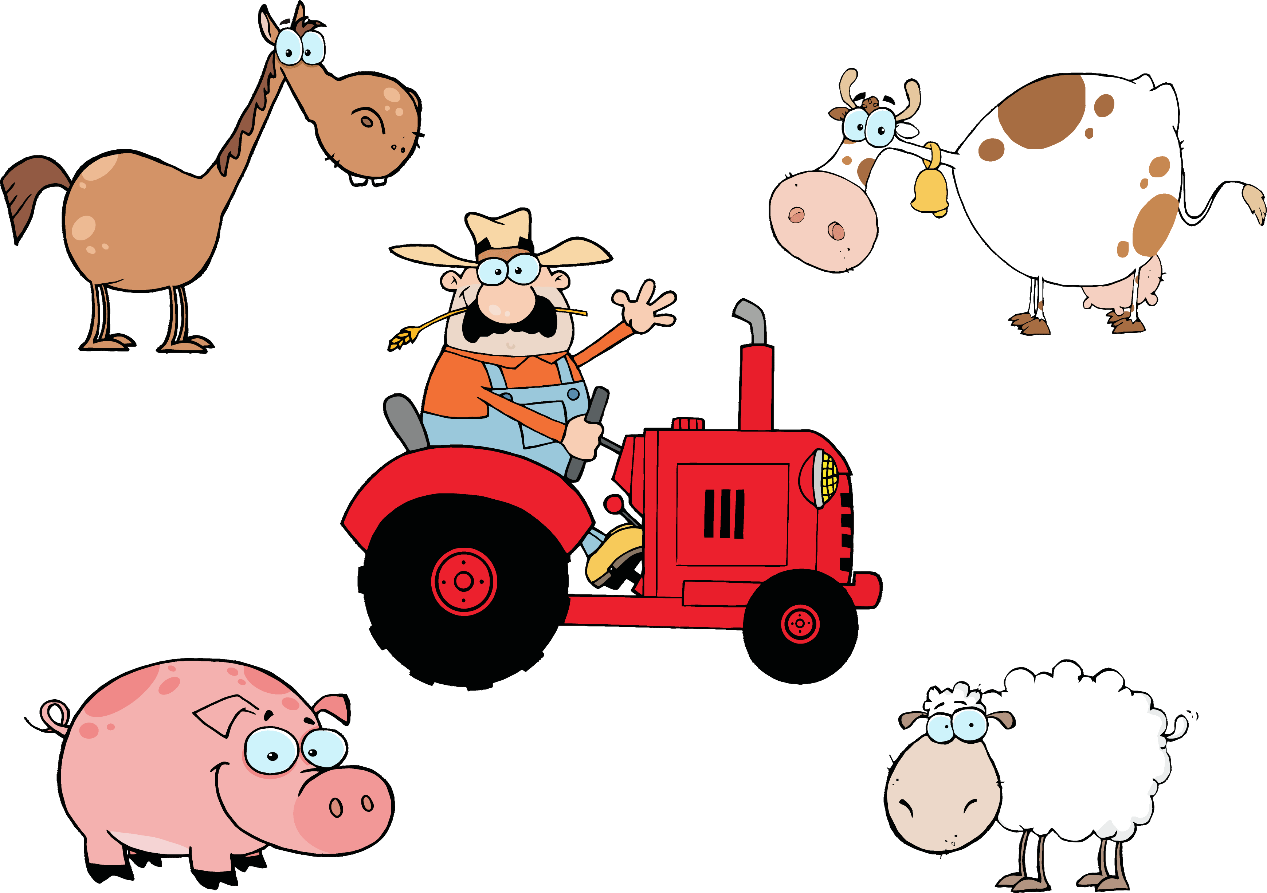
Fiction Books
Books that are not true
Made up Stories

Slide 11
Nonfiction Books
Books that are not made up
Contain factual information

Slide 12
Easy Books
Books that can be read by everyone.
Usually picture books

Slide 13
Easy Chapter Books
Chapter books that are good for some Kindergartens and students in grades 1-3.
Less words and more pictures than regular chapter books

Slide 14
Reference Books
Books that can be used to confirm facts.
Information is intended to be found quickly when needed.
Cannot be removed from library or signed out.

Slide 15
Periodicals
A magazine or newspaper
Comes at regular intervals (usually once a month)

Slide 16
Sections in the Library
E (Easy)
Easy Chapter Books
Fiction
Nonfiction
Reference
Periodicals
Circulation Desk
Computers

Slide 17
Let’s Go On a Scavenger Hunt!
With a Partner or Group, You Will Complete the Library Scavenger Hunt Sheet

Slide 18
Let’s Get Ready for a Story!

